Slide 1

Week #2
AI Academy®
1
Day 1:
Introduction to Daraz
Daraz Seller Benefits
Seller Account Creation
Verification and Documents Required
Guidance and support for Account verifications

Slide 2
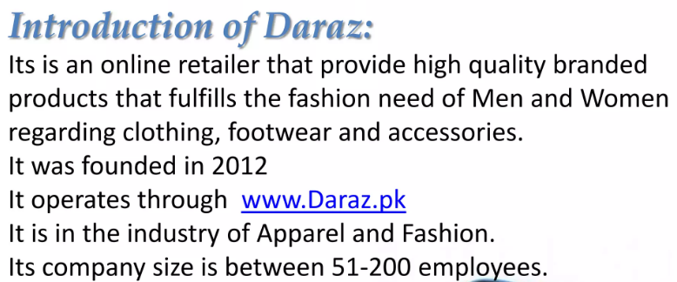
Week #2
AI Academy®
2

Slide 3
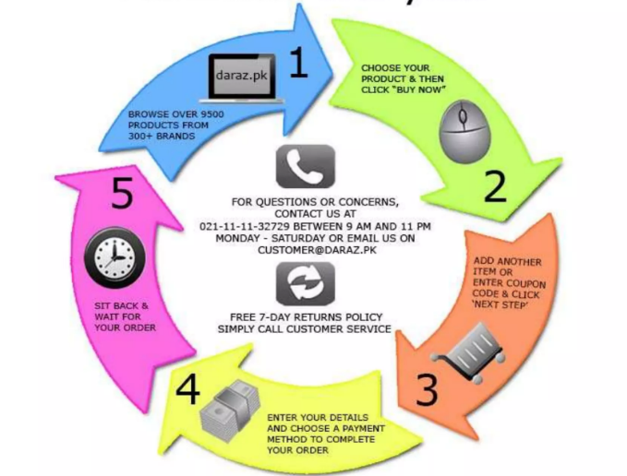
Week #2
AI Academy®
3

Slide 4
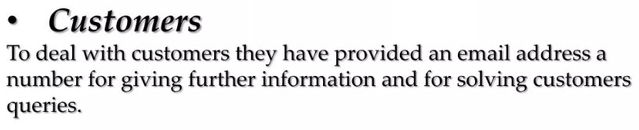
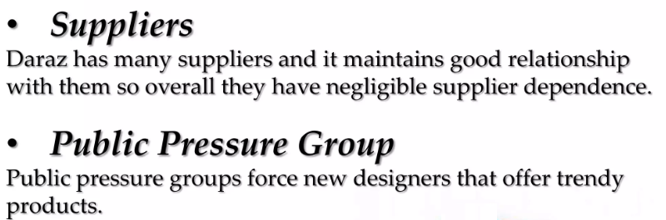
Week #2
AI Academy®
4

Slide 5

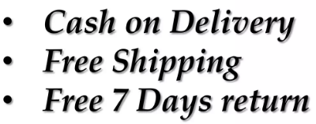


Week #2
AI Academy®
5

Slide 6
Week #2
AI Academy®
6
Day 2:
Introduction to Seller Dashboard
Various Sections and Tools
Order Management
Create Mock Orders
Reviews & Feedbacks

Slide 7
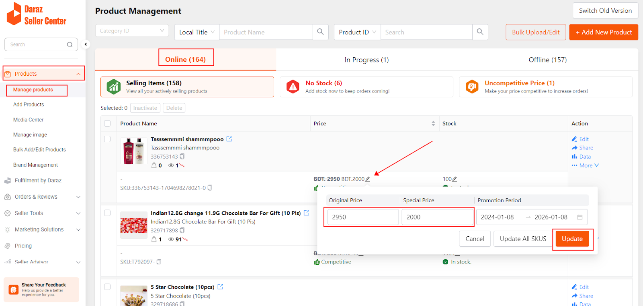
Week #2
AI Academy®
7

Slide 8
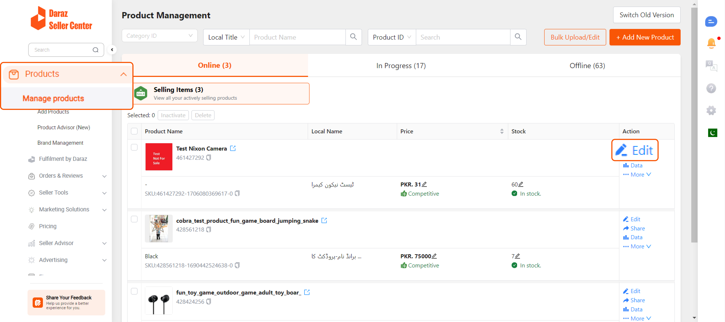
Week #2
AI Academy®
8

Slide 9
Week #1
AI Academy®
9
Day 3:
Product listing guidelines
Listing requires
Title, Description, Images
Creating Sample Product
Review and Feedback on listing

Slide 10
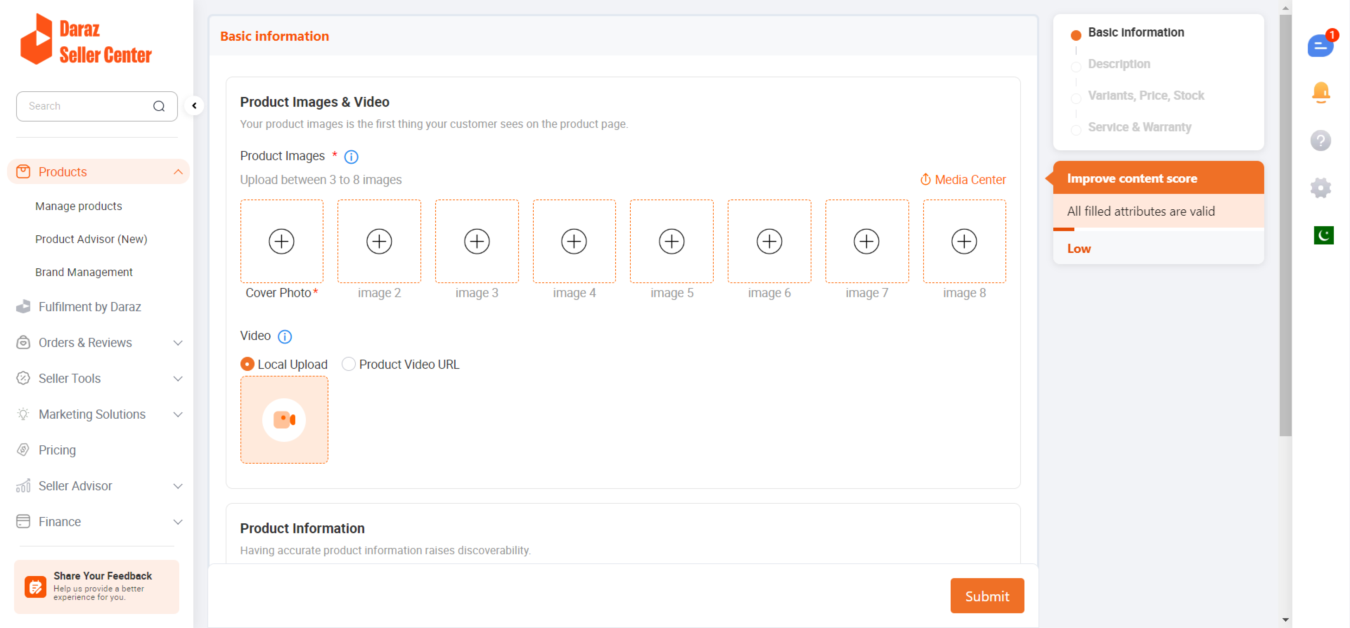
Week #2
AI Academy®
10

Slide 11
Week #1
AI Academy®
11
Day 4:
Explore Seller Store front Daraz
Guidelines, personalizing
Banners, logos and Brand identity
Troubleshooting and assistance

Slide 12
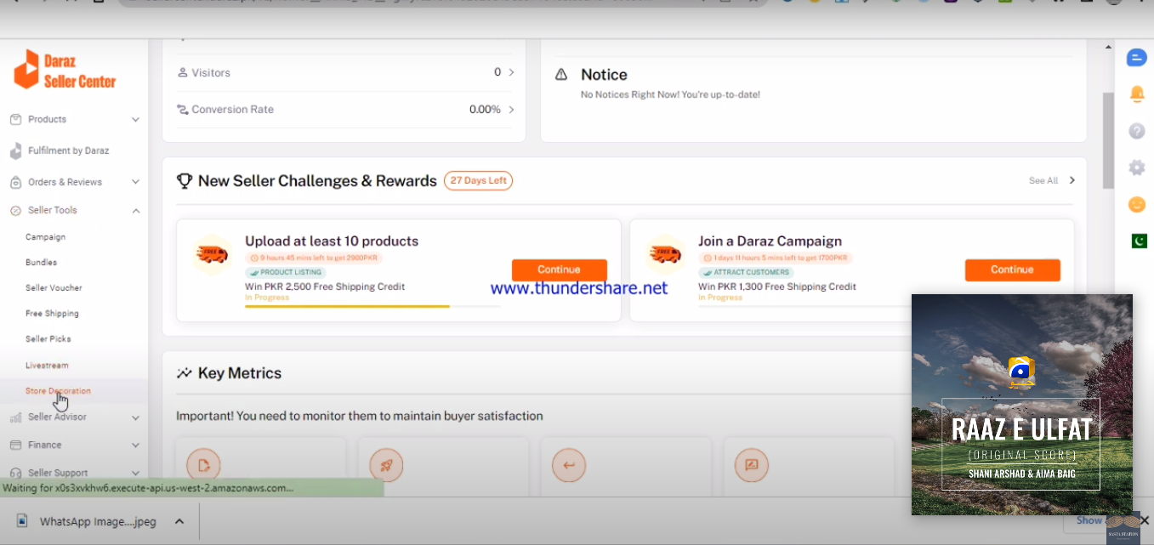
Week #1
AI Academy®
12

Slide 13
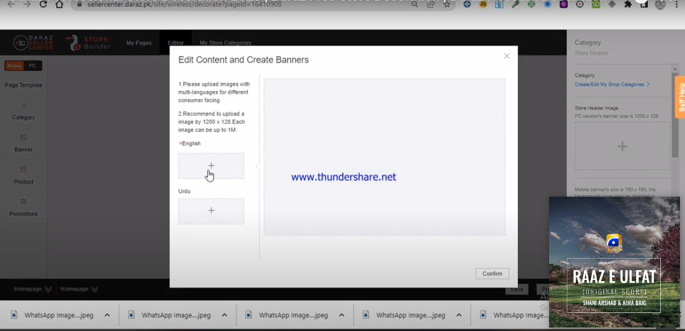
Week #1
AI Academy®
13

Slide 14
Week #1
AI Academy®
14
Day 5:
Overview Marking tools for Seller Daraz
Explanation
Promotions, discounts and Sponsoring
Inquiries and managing Orders
Review Inquiries and discussion

Slide 15
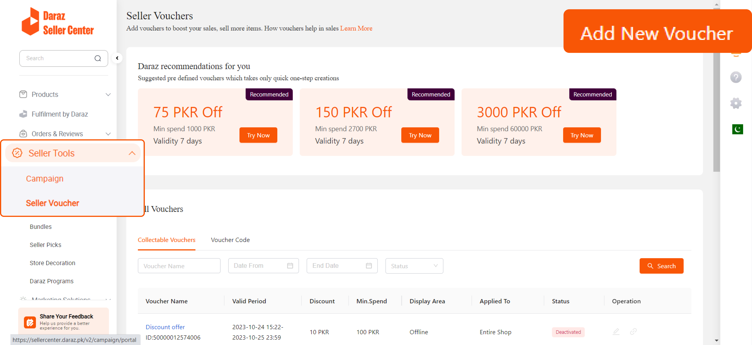
Week #1
AI Academy®
15

Slide 16
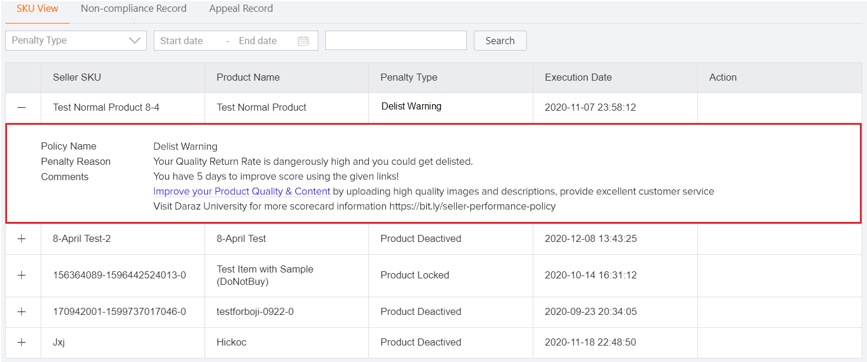
Week #1
AI Academy®
16

